Slide 1
USER GUIDE BIKE Tracker
Werner Meihuizen, David Meijer en Remco de groot

Slide 2
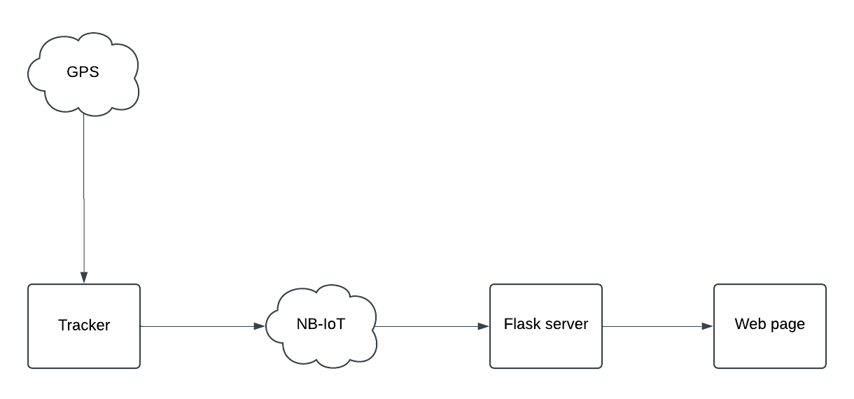
Diagram

Slide 3
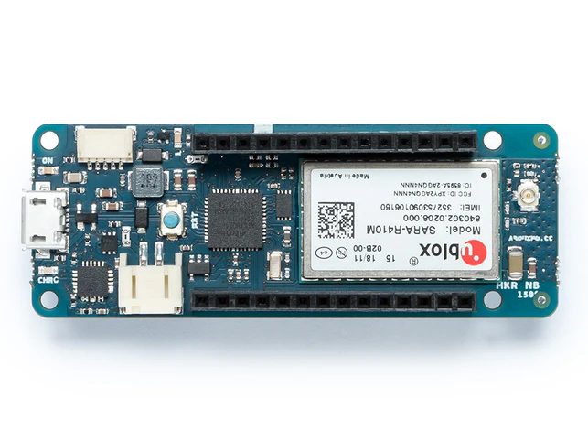
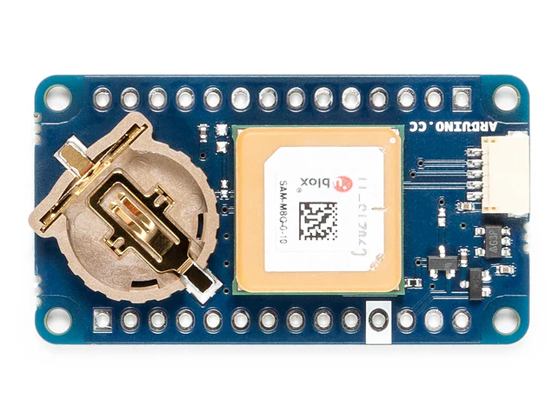
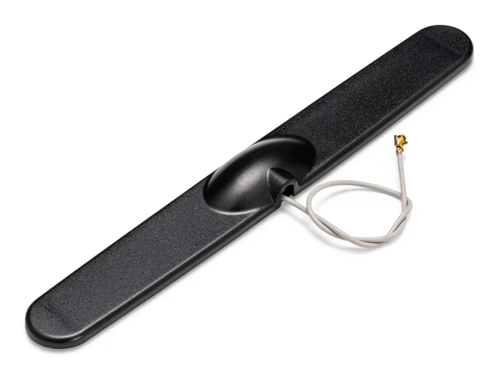
Required components
Sim card with NB-IOT capabilities
Arduino MKR NB 1500
Arduino MKR GPS Shield
Dipole Pentaband Waterproof Antenna
Eslof cable
Flask server to receive and show data.

Slide 4
Choices
Arduino MKR GPS Shield has built in GPS
Arduino MKR NB 1500 has a sim card slot, the shield can go on top and easy to attach antenna.
Dipole Pentaband Waterproof Antenna cane with the Arduino MKR NB 1500
Flask easy to setup

Slide 5
Wireless technology
Why NB-IoT?
Utilizes the cellular network for wide coverage.
Ensures data transmission regardless of location.
Frequency and Range in Europe:
Operates on 800MHz or 900MHz bands (2).
Coverage up to 10 kilometers (2).
Notes:
Orthogonal frequency-division multiplexing: multiple carrier frequencies. Used for wideband digital communication. The bit stream is divided into multiple streams. Multiple subcarriers with overlapping spectra. Multiple bits send at the same time.
Singe-Carrier FDMA: change data into symbols and use Discrete Fortier Transformation to change it into frequency signals. The signals are placed into subcarriers. The signals are transformed into waves and send.

Slide 6
Wireless technology
Key Features of NB-IoT:
Reusing existing infrastructure for lower power devices.
Low-power wide-area network (LPWAN).
Maximum bandwidth: 200kHz (1).
Downlink speed: Up to 127 kbit/s (1).
Uplink speed: Up to 159 kbit/s (1).
Latency: Between 1.6 and 10 seconds (1).
Half-duplex communication (can’t send and receive simultaneously).
Transmit power options: 14/20/23 dBm (1).
Device can be asleep when not sending/receiving data.
Orthogonal frequency-division multiplexing modulation for downlink(1)
Single-carrier FDMA modulation for uplink (1)
Notes:
Orthogonal frequency-division multiplexing: multiple carrier frequencies. Used for wideband digital communication. The bit stream is divided into multiple streams. Multiple subcarriers with overlapping spectra. Multiple bits send at the same time.
Singe-Carrier FDMA: change data into symbols and use Discrete Fortier Transformation to change it into frequency signals. The signals are placed into subcarriers. The signals are transformed into waves and send.

Slide 7


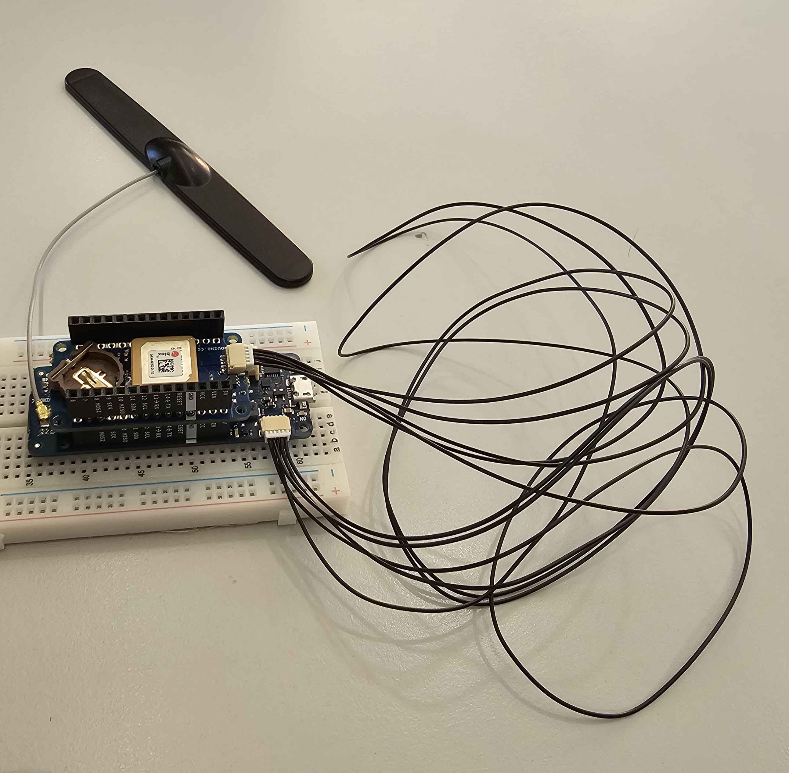
Tracker
Use sim card and antenna to connect to NB-IOT network
Arduino MKR GPS Shield to get the coordinates of its current location
The Arduino MKR NB 1500 sends the location data with a timestamp.

Slide 8
Flask webserver
Receives the location data and saves the timestamp
Data saved in database
When needed data is requested from database
Display data on frontend

Slide 9
Frontend
JavaScript on a web page
leaflet.js library to display a map
Displays the location of the bike and your own
Place the map using a div
Gets data from flask webserver through an api

Slide 10
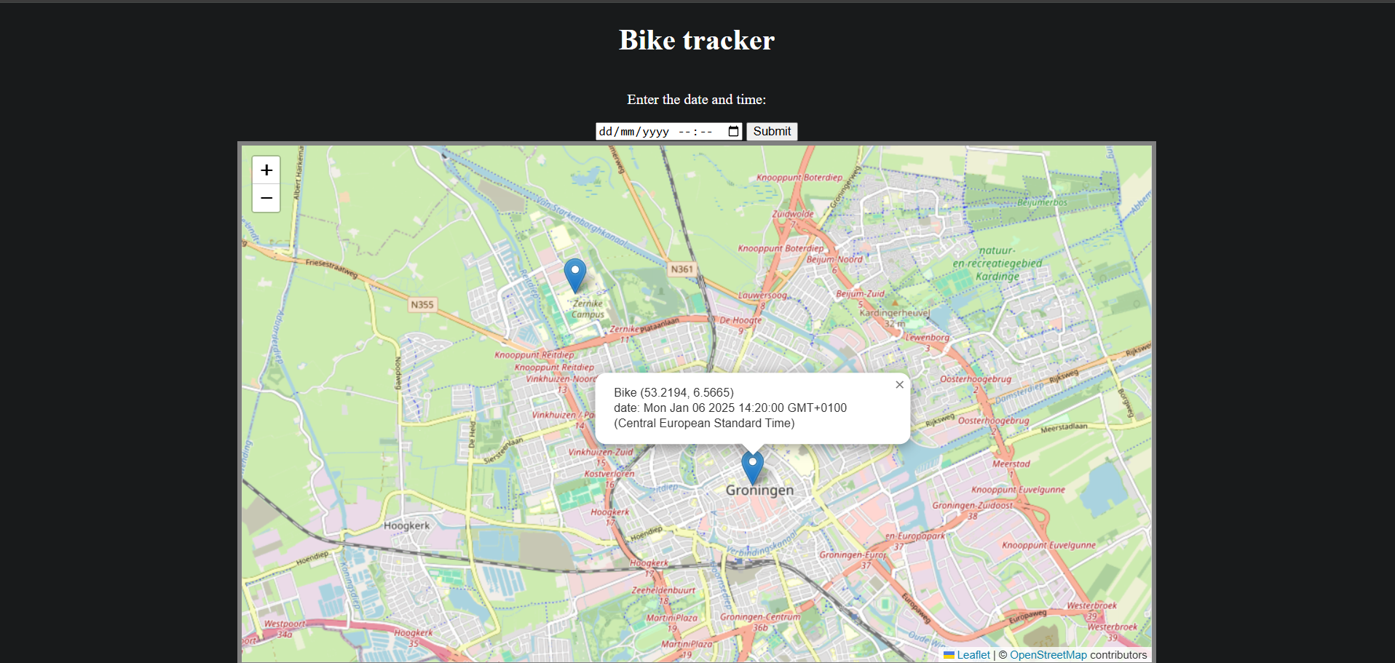
Frontend

Slide 11
Troubleshooting
Unable to connect to NB-IoT
Sim card works as expected
Low power unless searching for network?
GPS same problem

Slide 12
Next steps
Fixing connectivity issue
Sending information to webserver
Verifying everything works

Slide 13
Sources
Wikipedia contributors. Narrowband IoT [Internet]. Wikipedia. 2024. Available from: https://en.wikipedia.org/wiki/Narrowband_IoT
What is Narrowband IoT (NB-IoT): A comprehensive guide [Internet]. A1 Digital. 2024. Available from: https://www.a1.digital/news/what-is-narrowband-iot-a-comprehensive-guide/#:~:text=NB%2DIoT%20frequency%20and%20range,range%20and%20penetrate%20buildings%20better.

Slide 14
Thank you!
Notes:
Orthogonal frequency-division multiplexing: multiple carrier frequencies. Used for wideband digital communication. The bit stream is divided into multiple streams. Multiple subcarriers with overlapping spectra. Multiple bits send at the same time.
Singe-Carrier FDMA: change data into symbols and use Discrete Fortier Transformation to change it into frequency signals. The signals are placed into subcarriers. The signals are transformed into waves and send.

